Slide 1
Functional Dependency

Slide 2

Functional Dependence
In a relation including attribute A and B, B is functional dependent on A if, for every valid occurrence, the value A determines the value B
If B is ‘Functional Dependent on’ A, then A ‘is the determinant of B’
All fields are functionally dependent on the primary key – or indeed any candidate key – be definition.

Slide 3
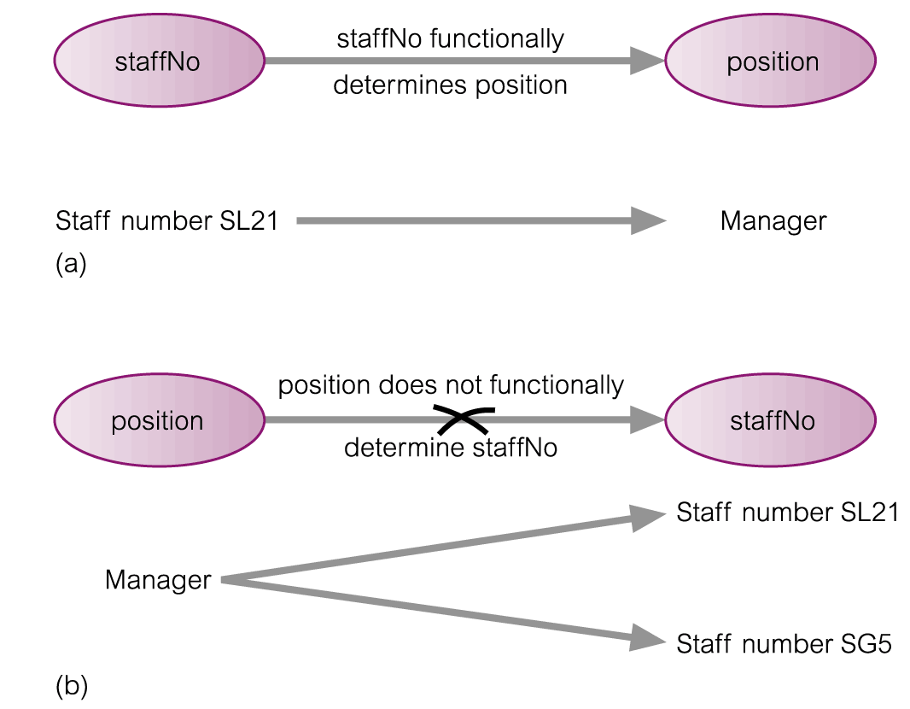
Example: Functional Dependency

Slide 4
Examples
loan-number → amount loan-number → branch-name loan-number → customer-name
×

Slide 5
Functional Dependency
Compound Determinants: If more than one attribute is necessary to determine another attribute in an entity, then such a determinant is termed a composite determinant.
Full Functional Dependency:
Only of relevance with composite determinants.
This is the situation when it is necessary to use all the attributes of the composite determinant to identify its object uniquely.
Example:
Full Functional Dependencies
order# line# qty price
A001 001 10 200
A002 001 20 400
A002 002 20 800
A004 001 15 300
(Order#, line#) → qty
(Order#, line#) → price

Slide 6
Functional Dependency
Partial Functional Dependency: This is the situation that exists if it is necessary to only use a subset of the attributes of the composite determinant to identify its object uniquely.
Example:
Full Functional Dependencies
student# unit# room grade
9900100 A01 TH224 2
9900010 A01 TH224 14
9901011 A02 JS075 3
9900001 A01 TH224 16
(student#, unit#) → grade
Partial Functional Dependencies
unit# → room
Repetition of data!

Slide 7
Examples of FD constraints
Social Security Number determines employee name
SSN → ENAME
Project Number determines project name and location
PNUMBER → {PNAME, PLOCATION}
Employee SSN and project number determines the hours per week that the employee works on the project
{SSN, PNUMBER} → HOURS

Slide 8
Trivial Dependencies
A functional dependency A₁A₂…A_{n}→B is said to be trivial if B is one of A’s.
For example: title, year →title is a trivial dependency.
We say that a dependency A₁A₂…A_{n}→B₁B₂…B_{m} is:
Trivial if the B’s are subset of A’s.
Nontrivial if at least one of the B’s is not among the A’s.
Completely nontrivial if none of the B’s is also one of the A’s.
Thus title, year → year ,length is nontrivial but not completely nontrivial.

Slide 9
Keys
A functional dependency allows us to express constraints that uniquely identify the values of certain attributes.
Whereas a key is a set of attributes that uniquely identifies an entire tuple.
However, a candidate key is always a determinant, but a determinant doesn’t need to be a key.

Slide 10
Closure
Let a relation R have some functional dependencies F specified.
The closure of F (usually written as F+) is the set of all functional dependencies that may be logically derived from F.
Often F is the set of most obvious and important functional dependencies.
F+, the closure, is the set of all the functional dependencies including F and those that can be deduced from F.

Slide 11
Axioms
To determine closure of the relation we need to learn some rules.
Developed by Armstrong in 1974.
There are six rules (axioms), using these RULES all possible functional dependencies may be derived.

Slide 12
Armstrong’s Axioms
1. Reflexivity Rule :
If Y ⊆ X,
then X → Y
each subset of X is functionally dependent on X.
2. Augmentation Rule :
If X → Y holds and
W is a set of attributes,
then WX → WY holds.
3. Transitivity Rule :
If X → Y and Y → Z holds,
then X → Z holds.

Slide 13
Derived Theorems from Armstrong’s Axioms
4. Union Rule :
If X → Y and X → Z holds,
then X → YZ holds.
5. Decomposition Rule :
If X → YZ holds,
then so do X → Y and X → Z.
6. Pseudotransitivity Rule :
If X → Y and WY → Z hold then so does WX → Z.

Slide 14
Examples of Armstrong’s Axioms
We can find all of F⁺ by applying :
if Y ⊆ X, then X → Y (reflexivity) loan-no → loan-no loan-no, amount → loan-no loan-no, amount → amount
if X → Y, then WX → WY (augmentation) loan-no → amount (given) loan-no, branch-name → amount, branch-name
if X → Y and Y → Z , then X → Z (transitivity) loan-no → branch-name (given) branch-name → branch-city (given) loan-no → branch-city

Slide 15
Example: Closure of set F of functional dependencies
R = (A, B, C, G, H, I) F = { A → B A → C CG → H CG → I B → H }
Find Closure of F: some members of F ⁺
A → H
by transitivity from A → B and B → H
AG → I
by augmenting A → C with G, to get AG → CG and then transitivity with CG → I
CG → HI
from CG → H and CG → I : “union rule”
GIVEN

Slide 16
Example:
Compute the closure of the following set F of functional dependencies for relation schema R = (A, B, C, D, E).
A →BC
CD →E
B→ D
E→ A
Solution:
A → BC, we can conclude: A → B and A → C. (decomposition)
A → B and B → D ➔ A → D (transitive)
A → CD and CD → E, A → E (union, decomposition, transitive)
A → A, we have (reflexive)
A → ABCDE from the above steps (union)
Since E → A, E → ABCDE (transitive)
Since CD → E, CD → ABCDE (transitive)
Since B → D and BC → CD, BC → ABCDE (augmentative, transitive)
Also, C → C, D → D, BD → D, etc.

Slide 17
Computing the Closure of Attributes - Algorithm
Starting with the given set of attributes, repeatedly expand the set by adding the right sides of FD’s as soon as we have included their left sides.
Eventually, we cannot expand the set any more, and the resulting set is the closure.
Let X be a set of attributes that eventually will become the closure.
First we initialize X to be {A₁, A₂, …, A_{n}}.
Now, repeatedly search for some FD in S:
B₁B₂…B_{m}→C
such that all of B’s are in the set X, but C is not. We then add C to X.
Repeat step 2 as many times as necessary until no more attributes can be added to X.
Since X can only grow, and the number of attributes is finite, eventually nothing more can be added to X.
The set X after no more attributes can be added to it is the: {A₁, A₂, …, A_{n}}⁺.

Slide 18
Closure
R(A,B, C)
FD: A->B, B->C
A⁺ ={A, B, C}
B⁺ = {B, C}
C⁺ = {C}

Slide 19
Closure
R(A,B, C, D, F, G)
FD: A->B, BC->DE, ABG->G
Find AC⁺ ?
AC⁺ = {A, B, C, D, E}

Slide 20
What is {A,B}⁺?
AB→C,
BC→AD,
D→E,
CF→B.
Solution:
{A, B}⁺ ⁼ {A, B, C, D, E}

Slide 21
Example
QUES. Given this FD for this R(A,B,C,D,E,F)
AB→ C
AD→ E
B→D
AF→B
Check if AB+ is a key for this relation?
AB+ is key if AB+ can find all the attribute of R
Solution:
AB→AB
B→D so B ⊆AB → AB+→ABD
AD→E so AD ⊆ABD→AB+→ABDE
AB→C so AB ⊆ABDE →AB+→ABCDE
AF→B so AF Not ⊆ABDE → AB+→ABCDE
AB not a key because it does not contain all attributes such as F

Slide 22
Example
R = (A, B, C, G, H, I) F = { A → B A → C CG → H CG → I B → H}
(AG) ⁺ ?
1. result = AG
2. result = ABCG (A → C and A → B)
3. result = ABCGH (CG → H and CG ⊆ AGBC)
4. result = ABCGHI (CG → I and CG ⊆ AGBCH
Is (AG) a candidate key ?
(A+) = BC, (G+) = G.
YES.

Slide 23
Other
Finding keys of the relation
Minimal Cover
Equivalence

